Slide 1

Data Analysis
Aswathy Sasi
CHRIST(Deemed to be university)

Slide 2
Purpose of Analysis
Understand the factors contributing to flight delays.
Analyze the performance of different aircraft models.
Explore trends in departure and arrival times.

Slide 3
Objectives
Data Overview
Analytical aaproach
Data Preprocessing (cleaning)
Data Visualizations
Interpretations

Slide 4
Dataset Overview
Dataset: Airline Dataset
Size: 1772 observations, 64 variables
Data Types: Numerical, Categorical

Slide 5
Analytical Approach
Tool Used:
Power BI

Slide 6
Data Preprocessing
Step 1- Remove Duplicates
Step 2 – removed columns
Day
Flight no
Customer delay code description because the "Customer Delay Description" and "Departure Delay Remarks" columns contain the same information, it would be redundant to keep both.
the information in "IATA Delay Code Description" already covers the reasons for departure delays comprehensively, then "Departure Delay Remarks" might be redundant.
Removed customer delay code, Carrier Controllable Status (Customer) for the same reason
can consider removing the "T/D (UTC)"(target departure) column if you already have the "STD (UTC)" (Scheduled Time of Departure) column, as they both represent planned departure times and may provide redundant information.

Slide 7
Data Preprocessing
Step 2 – removed columns
We are removing the 'Arrival Delay Remarks', 'Customer Delay Code Description', 'Customer Delay Code', and 'Carrier Controllable Status (Customer)' columns because the information in "IATA Delay Code Description" already covers the reasons for arrival delays comprehensively
Steo 3 - Replaced null values
Step 4- Changed the data type

Slide 8
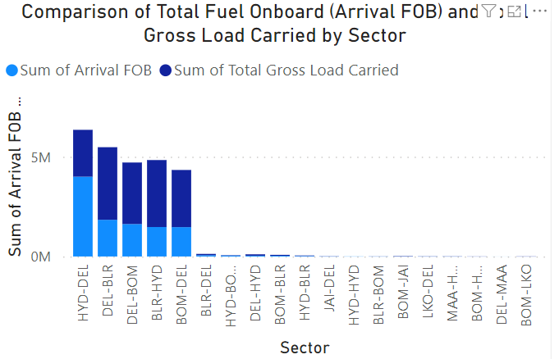
Data Visualizations
The comparison of the total fuel onboard (Arrival FOB) and the total gross load carried by sector provides insights into the efficiency and capacity utilization of different flight sectors.
By examining the relationship between these two variables, we understood that how efficiently hyd-del sector utilizes its fuel and cargo capacity.

Slide 9
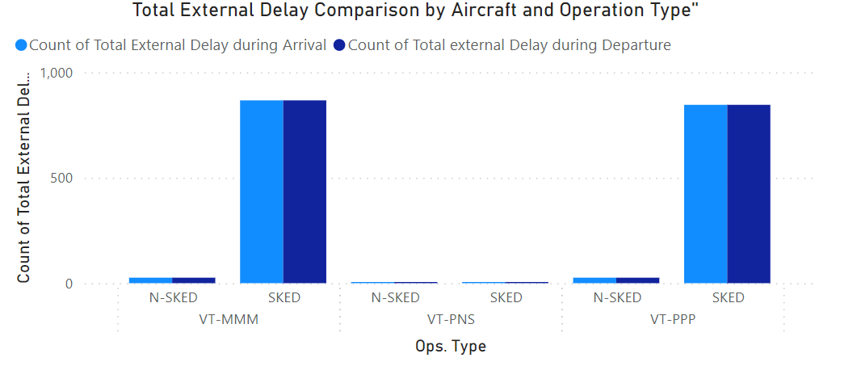
Data Visualizations

Slide 10
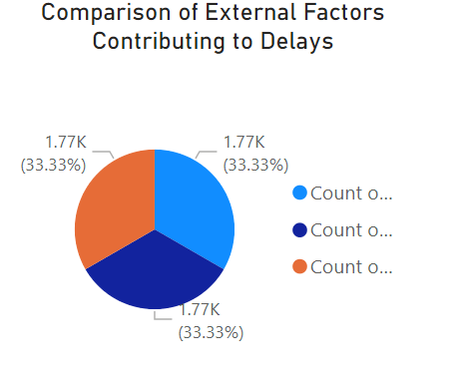
Data Visualizations
It shows that cargo, miscellaneous, and weather have the same impact on delay

Slide 11
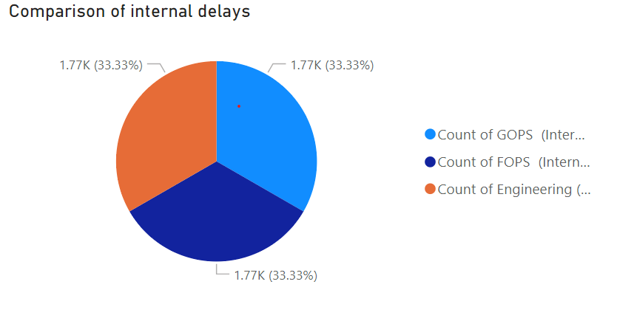
Data Visualizations

Slide 12
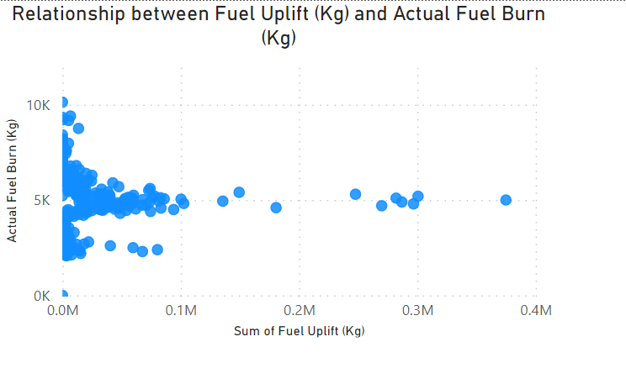
Data Visualizations
it indicates a weak or no correlation between the variables represented by the x-axis and y-axis.
This alignment suggests that changes in the x-variable do not result in consistent or predictable changes in the y-variable.
In other words, there is little to no linear relationship between the two variables being plotted. This could mean that the variables are independent of each other

Slide 13
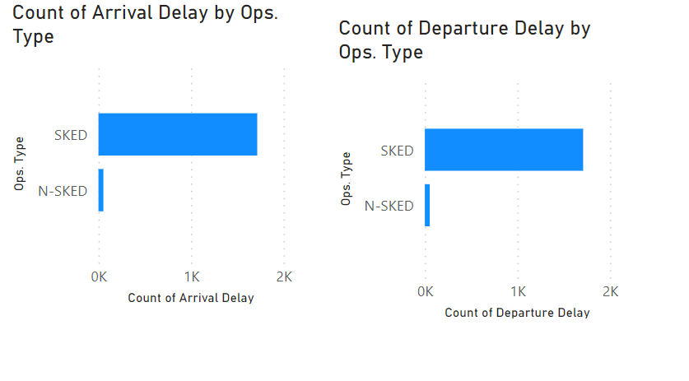
Data Visualizations
occurrence of arrival delay or departure delay on scheduled flights can be influenced by various factors, including operational issues(air craft maintanence), weather conditions, airport congestion, air traffic control delays, mechanical issues with the aircraft, and scheduling inefficiencies

Slide 14
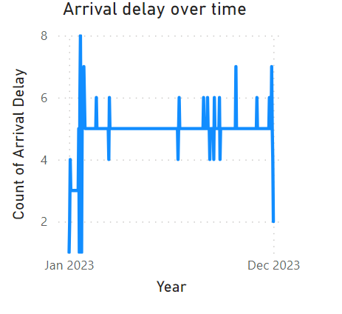
Data Visualizations
Most of the arrival delay happened during mid January because weather(winter ), holiday(end of holiday seasons, so there might be a chance for lot of travel)

Slide 15
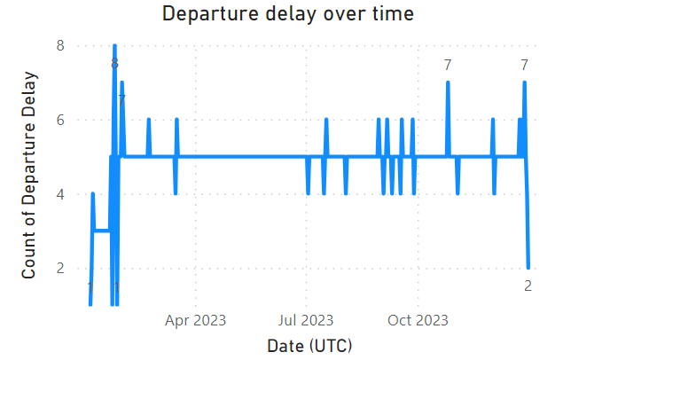
Data Visualizations
Most of the departure delay happened during mid April because April may coincide with peak travel seasons or weather patterns that could affect flight operations

Slide 16
Conclusion
In conclusion, this presentation has provided valuable insights into the factors influencing flight delays and operational performance within the aviation industry.
Through detailed analysis and visualization of various data metrics, we have gained a deeper understanding of the challenges faced by airlines

Slide 17
THANK YOU

